Slide 1


E-MEDICINE
STORE TO SAVE LIVES!!!
PRESENTED BY:
A. AMRUTHAMATHI
S. ANU
C. CHARUMATHI
R. INBA
P. HARINI
B. LAVANYA
A. VELAMMAL
GUIDED BY:
POOJA MEHTA

Slide 2
INTRODUCTION
E-Medicine which empowers people to buy medicines from the convenience of home 24/7 and 365 days a year. Following a bulk purchase formula, we are able to provide our customers with the lowest price for all medicines.
With fast sales and inventory rotation, we always provide a fresh batch of medicines to our customers. Orders will be delivered to your doorstep.
E-Medicine manages the details of Medical Shop, Stocks, Inventory, Sells and Company. E-Medicine does it all with a touch of a button.
Bringing along the continuous development, supreme support systems, trustworthy customer care, addition of features on a regular basis and it is a no-brainer to choose E-Medicine.

Slide 3
OBJECTIVE
The objective of e-medicine is to deliver medicine at an affordable cost to all places.
The primary mission of e-medicine is to manage the use of medications and provide good quality of medicines to the customers.
Goals include the selection, prescription, procuration, delivery, administration and review of medications to optimize patient outcomes.
Any medical shop that operates over the internet and sends orders to customers through e-mail, shipping line or an online portal is called an e-medicine.

Slide 4
TECHNOLOGIES USED
Java:
Java is a class-based, object-oriented programming language and is designed to have as few implementation dependencies as possible.
JAVA was developed by James Gosling at Sun Microsystems Inc in the year 1995, later acquired by Oracle Corporation.
It is a simple programming language. Java makes writing, compiling, and debugging programming easy. It helps to create reusable code and modular programs.

Slide 5
TECHNOLOGIES USED
Spring Boot:
Spring Boot is an open-source micro framework maintained by a company called Pivotal.
It provides Java developers with a platform to get started with an auto configurable production-grade Spring application.
The main goal of the Spring Boot framework is to reduce overall development time and increase efficiency by having a default setup for unit and integration tests.

Slide 6
TECHNOLOGIES USED
Rest API:
Representational State Transfer (REST) is an architectural style that defines a set of constraints to be used for creating web services.
REST API is a way of accessing web services in a simple and flexible way without having any processing.
A request is sent from client to server in the form of a web URL as HTTP GET or POST or PUT or DELETE request. After that, a response comes back from the server in the form of a resource which can be anything like HTML, XML, Image, or JSON. But now JSON is the most popular format being used in Web Services.

Slide 7
TECHNOLOGIES USED
JPA:
JPA stands for Java Persistence API (Application Programming Interface). It was initially released on 11 May 2006.
It is a Java specification that gives some functionality and standard to ORM tools. It is used to examine, control and persist data between Java objects and relational databases.
Hibernate:
Hibernate is a framework in Java which comes with an abstraction layer and handles the implementations internally. Hibernate is a ORM tool means it support Object relational mapping. In hibernate each record is represented as a Object.
The implementations include tasks like writing a query for CRUD operations or establishing a connection with the databases.

Slide 8
TECHNOLOGIES USED
MySQL:
MySQL is a relational database management system based on the Structured Query Language, which is the popular language for accessing and managing the records in the database.
MySQL is open-source and free software under the GNU license. It is supported by Oracle Company.
Every Database is composed of one or more tables. These Tables, which structure data into rows and columns, Impose organization on the data.

Slide 9
TECHNOLOGIES USED
Postman:
Postman is a standalone software testing API (Application Programming Interface) platform to build, test, design, modify, and document APIs.
API acts like an interface between a couple of applications and establishes a connection between them.
It is a simple Graphic User Interface for sending and viewing HTTP requests and responses. It can build multiple HTTP requests − POST, PUT, GET, PATCH and translate them to code.

Slide 10
HARDWARE SPECIFICATIONS
Intel Core i5
256 MB Ram
512 KB Cache Memory
Hard disk 10 GB (OPTIONAL)

Slide 11
SOFTWARE SPECIFICATIONS
Technology : JAVA
Business Layer : Spring Boot , Spring Framework, Rest API, JPA and Hibernate
Database : MySQL
Web Server : Tomcat Server
Source code Editor : Visual Studio Code

Slide 12
PROPOSED SYSTEM
The aim is to make the ordering process and delivery systems of medicines much easier and customer-friendly. It’s very important to make a user friendly environment.
The E-Medicine will be developed by combining several technology (ANGULAR, HTML5, SPRINGBOOT, CSS ). Among these technologies, CSS is responsible for the web visual style on the device.
In E-medicine the customer selects the required medicines and orders them by a single click. Before it, the customer needs to create a login account and fill all the details like name, address, any id no etc…
The business goal for the application is to provide the medicines to all people and admin will provide the supplier details.

Slide 13
MODULES
Admin:
Admin has the official powers to control the flow of the data from one part of the system to the other. Admin can manipulate the access of the users to the data. Hence all the data will be reflected in clean and well data in the interfaces.
Customer:
Check all the medicines and give order of medicines. Check order status and see recently add cart medicines.
Order:
The order from the dealer is taken through phone and the medicines; quality is entered by an employee.

Slide 14
MODULES
Cart:
After trade, the medicines will be directed to the cart. In the cart unit we can get the total quantity of medicines available.
Medicines:
Detail information about medicines which is provided by admin.

Slide 15
SPRING ANNOTATIONS
@CrossOrigin annotation– Cross-Origin Resource Sharing (CORS) is a security concept that allows restricting the resources implemented in web browsers. It prevents the JavaScript code producing or consuming the requests against different origin.
@RestController annotation- RestController is used for making restful web services with the help of the @RestController annotation. This annotation is used at the class level and allows the class to handle the requests made by the client.
@RequestMapping annotation- RequestMapping annotation is used to map web requests onto specific handler classes and/or handler methods. @RequestMapping can be applied to the controller class as well as methods.

Slide 16
SPRING ANNOTATIONS
@PostMapping annotation- PostMapping annotation maps HTTP POST requests onto specific handler methods. It is a composed annotation that acts as a shortcut for @RequestMapping(method = RequestMethod. POST) .
@GetMapping annotation- GetMapping annotation maps HTTP GET requests onto specific handler methods. It is a composed annotation that acts as a shortcut for @RequestMapping(method = RequestMethod. GET) .
@Entity annotation- It defines that a class can be mapped to a table. And that is it, it is just a marker, like for example serializable interface.

Slide 17
SPRING ANNOTATIONS
@onetoone annotation- The @OneToOne JPA annotation is used to map the source entity with the target entity. In this example, we create Instructor and Instructor Detail entities and we make a one-to-one mapping between them. The one-to-one association can be either unidirectional or bidirectional.
@manytomany annotation- The @ManyToMany annotation is used in both classes to create the many-to-many relationship between the entities. This association has two side i.e. the owning side and the inverse side.
@overriding annotation- @Override annotation informs the compiler that the element is meant to override an element declared in a superclass. While it is not required to use this annotation when overriding a method, it helps to prevent errors.

Slide 18
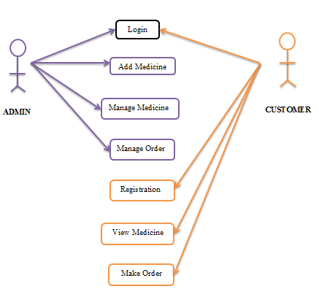
USE CASE DIAGRAM

Slide 19
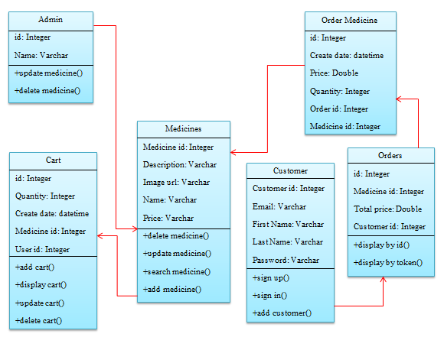
CLASS DIAGRAM

Slide 20
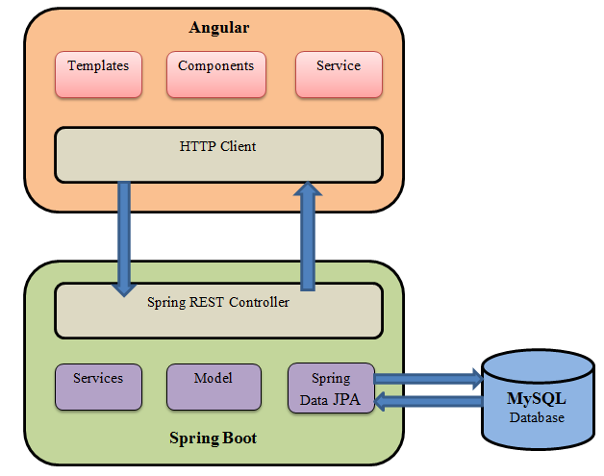
CONNECTING FRAMEWORK

Slide 21
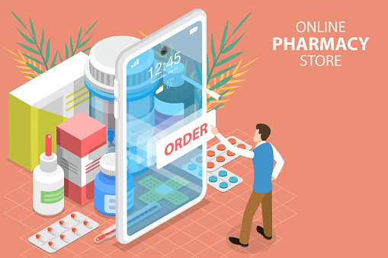
OUTPUT SCREENS

Slide 22
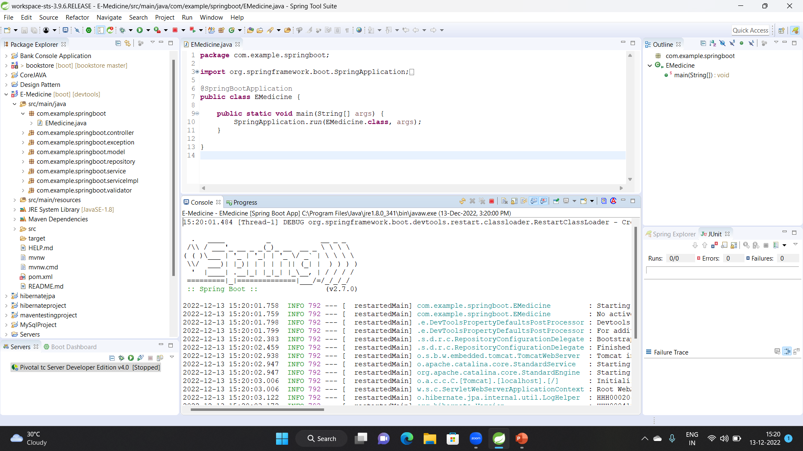

Slide 23
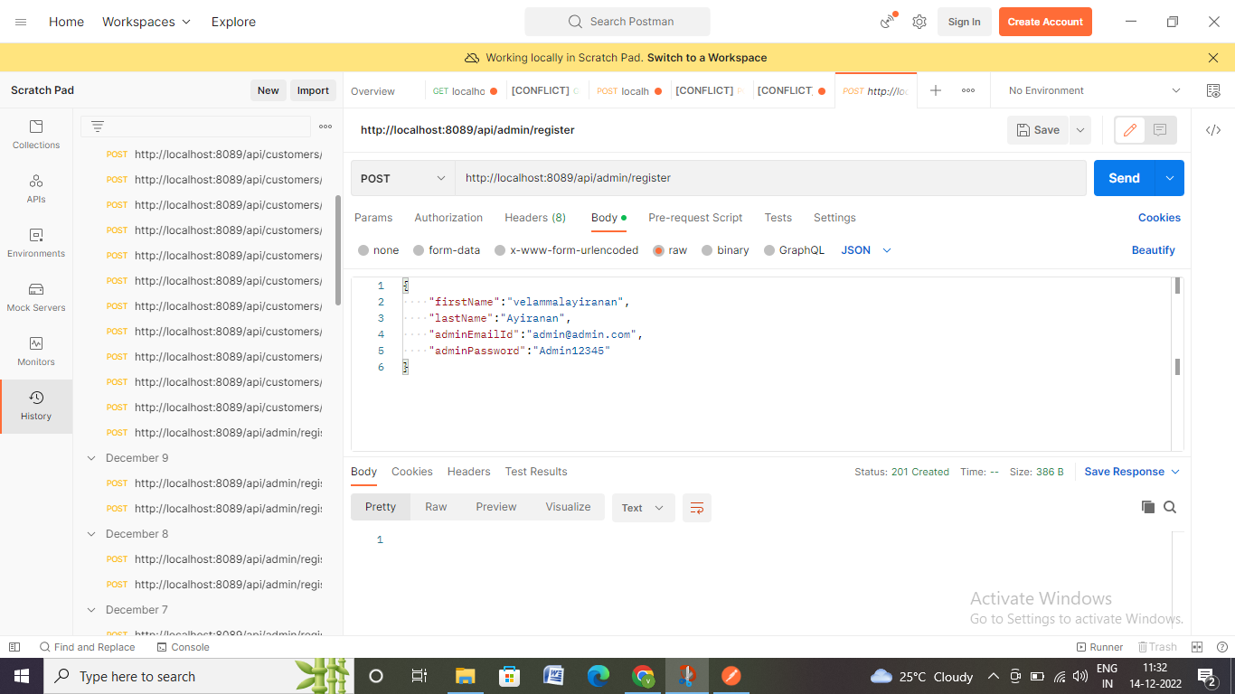

Slide 24
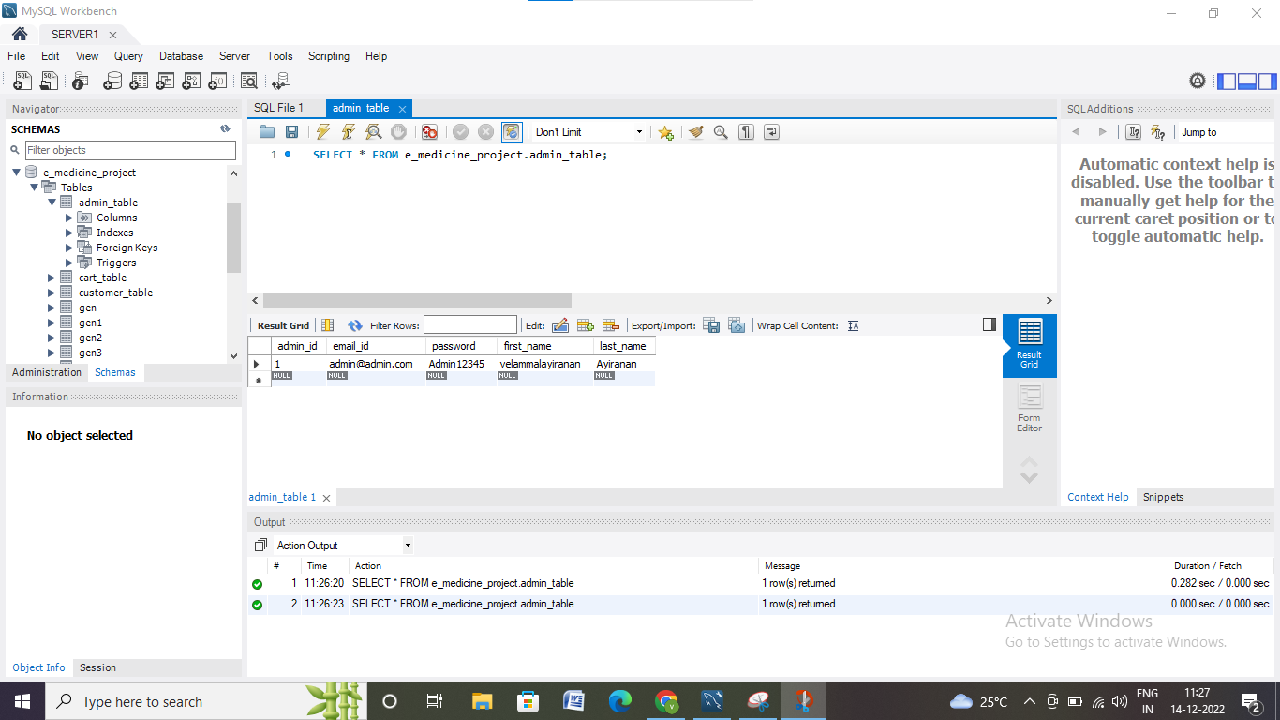

Slide 25
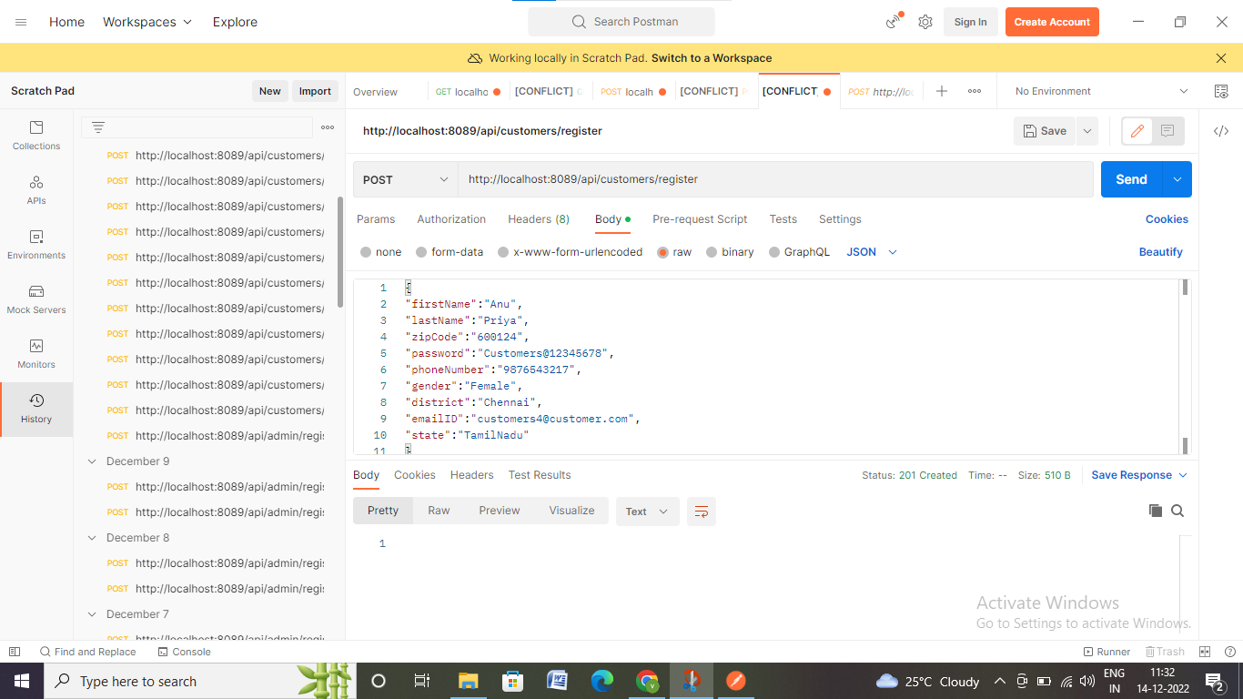

Slide 26
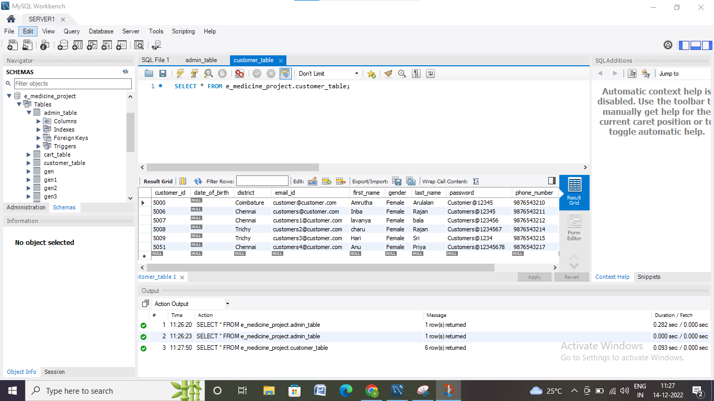

Slide 27
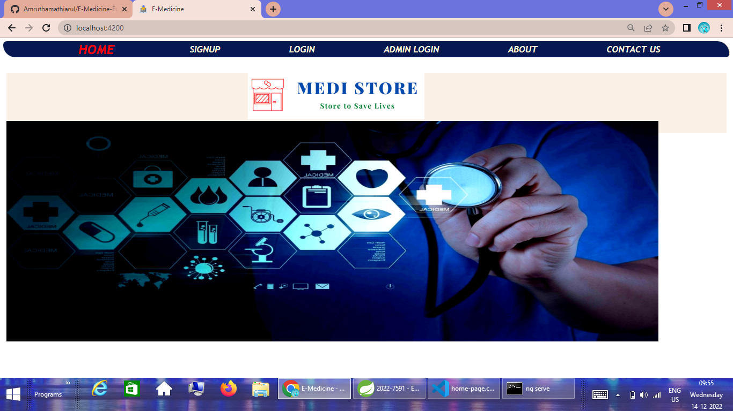

Slide 28
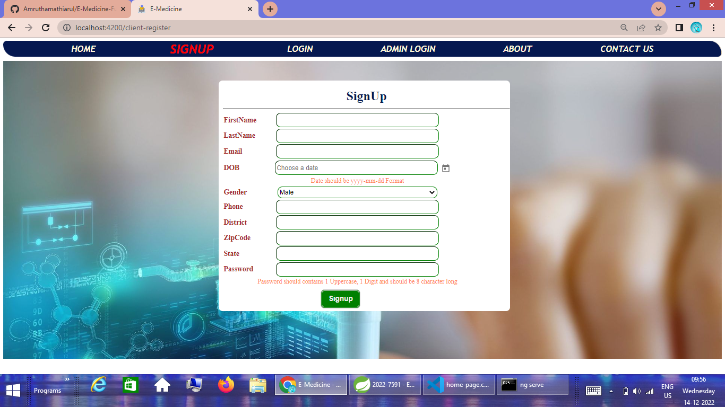

Slide 29
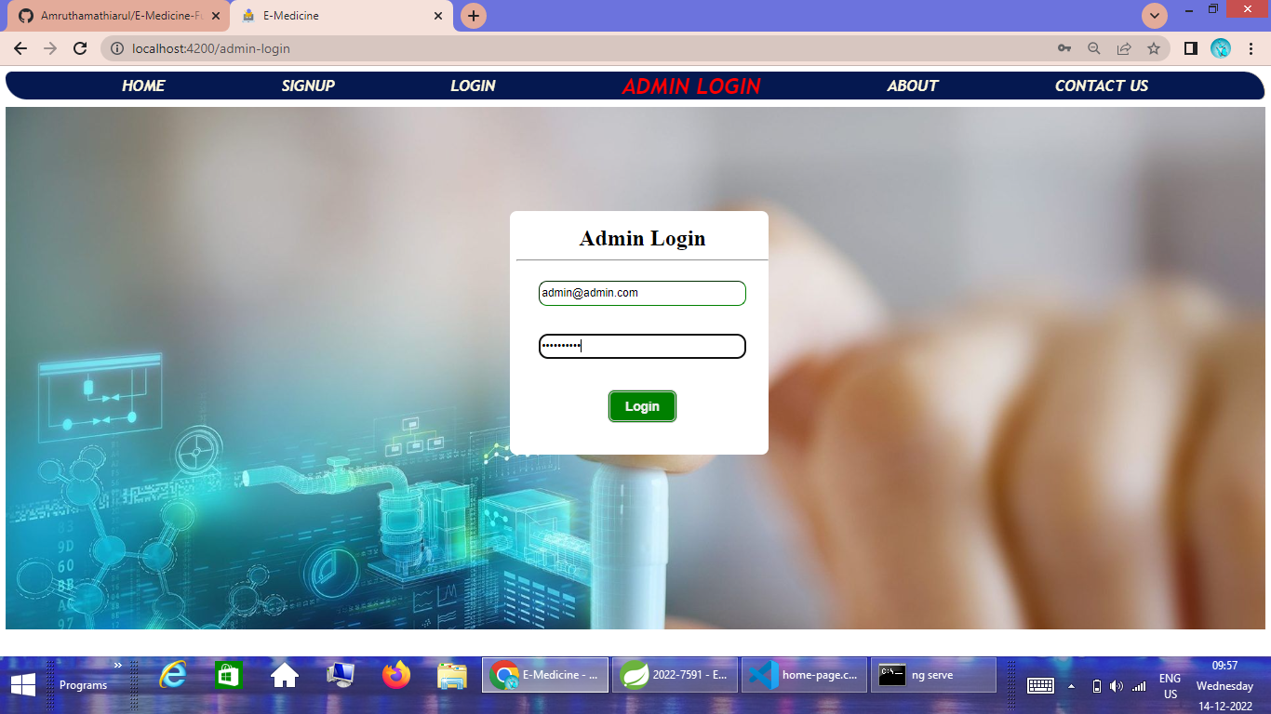

Slide 30
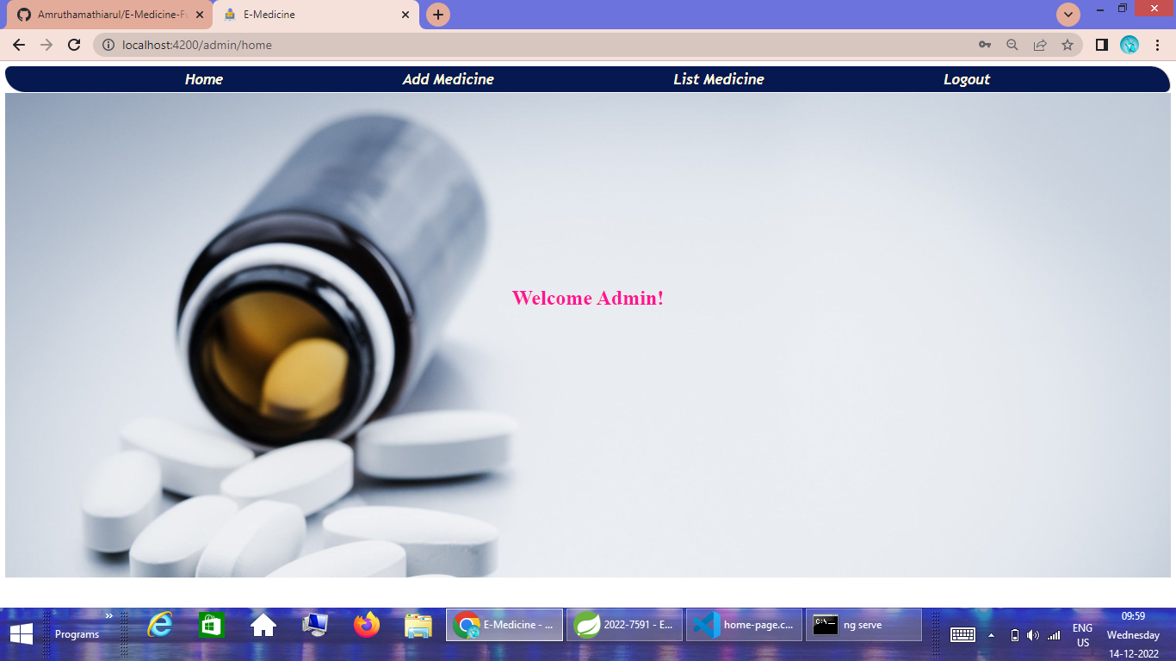

Slide 31
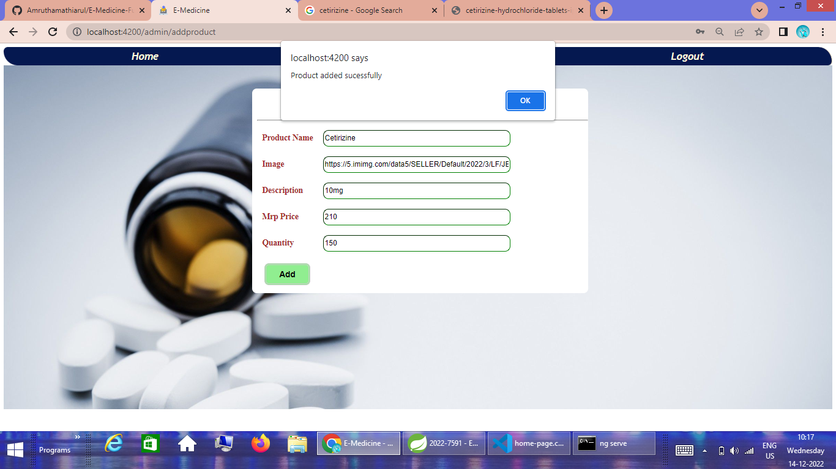

Slide 32
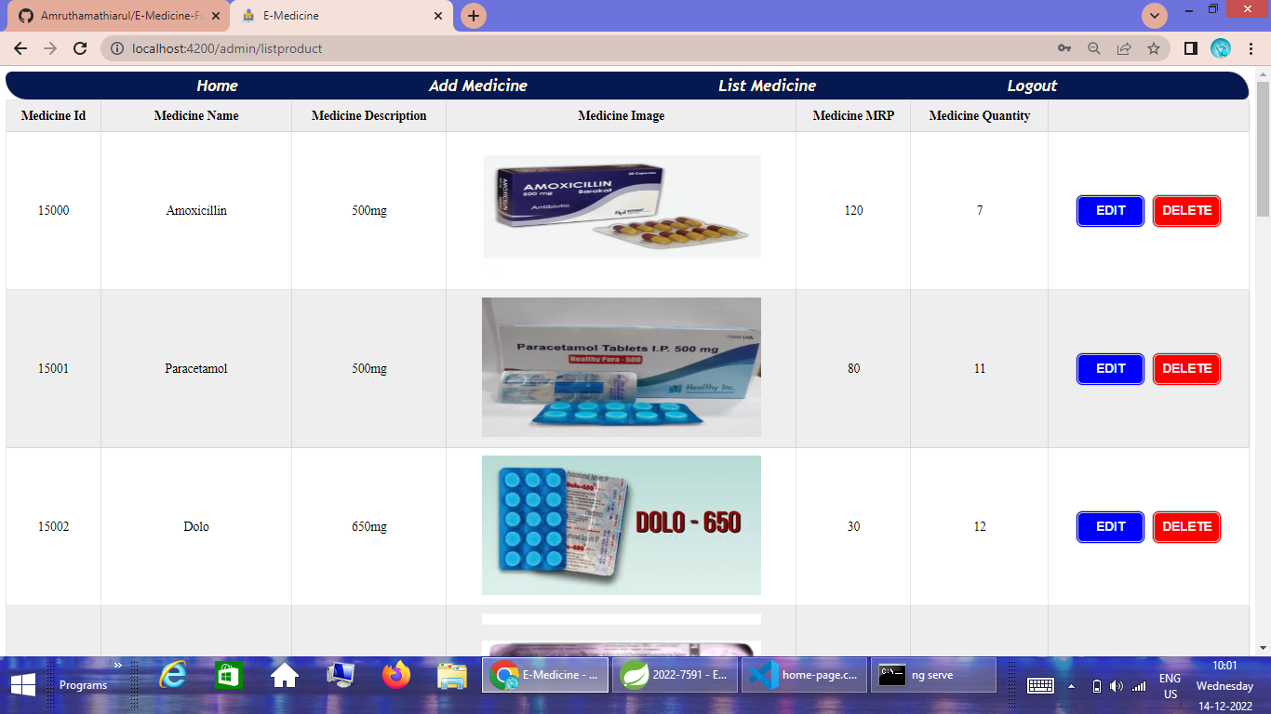

Slide 33
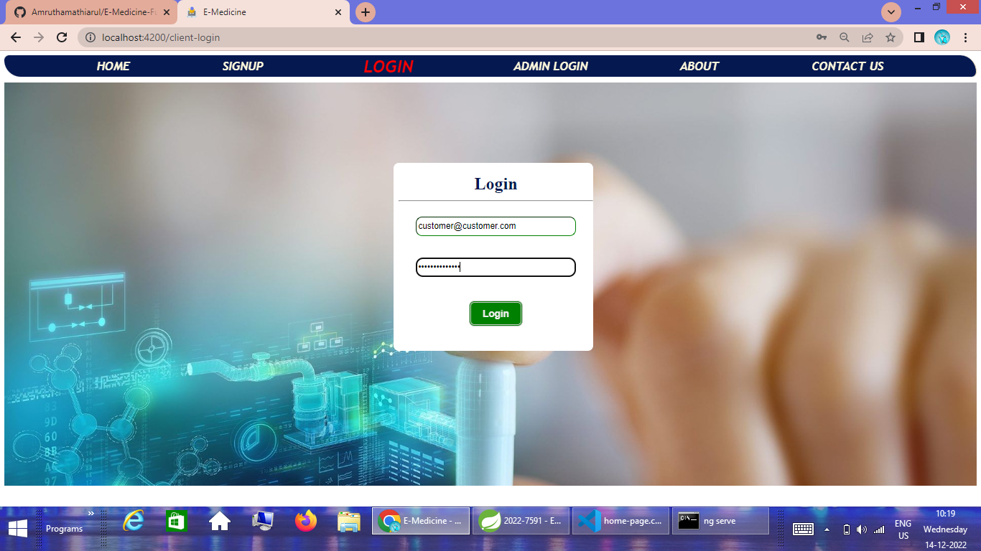

Slide 34
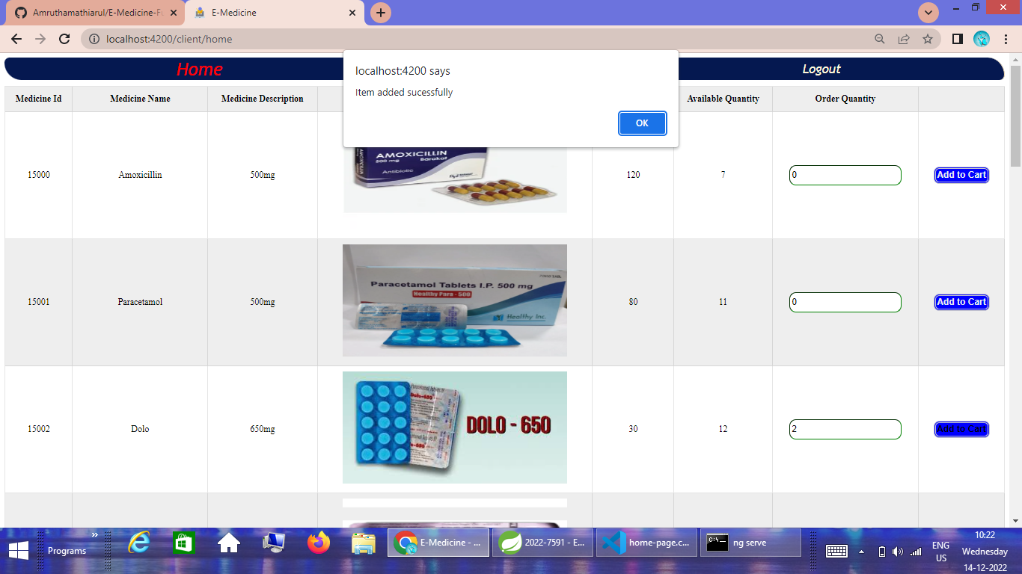

Slide 35
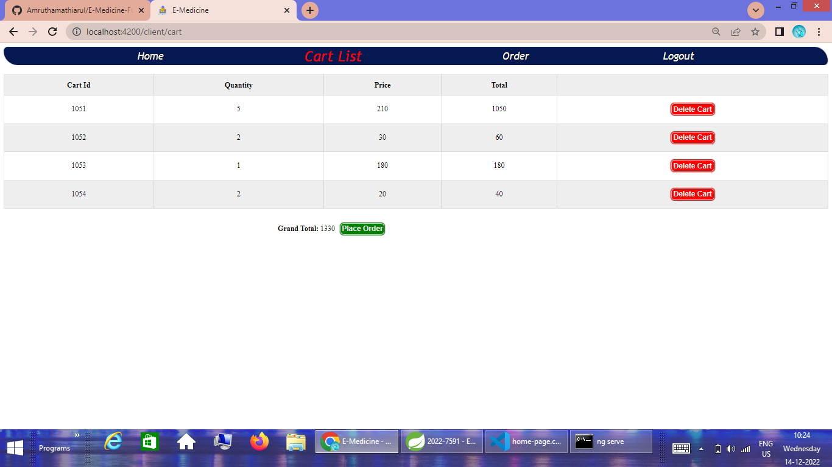

Slide 36
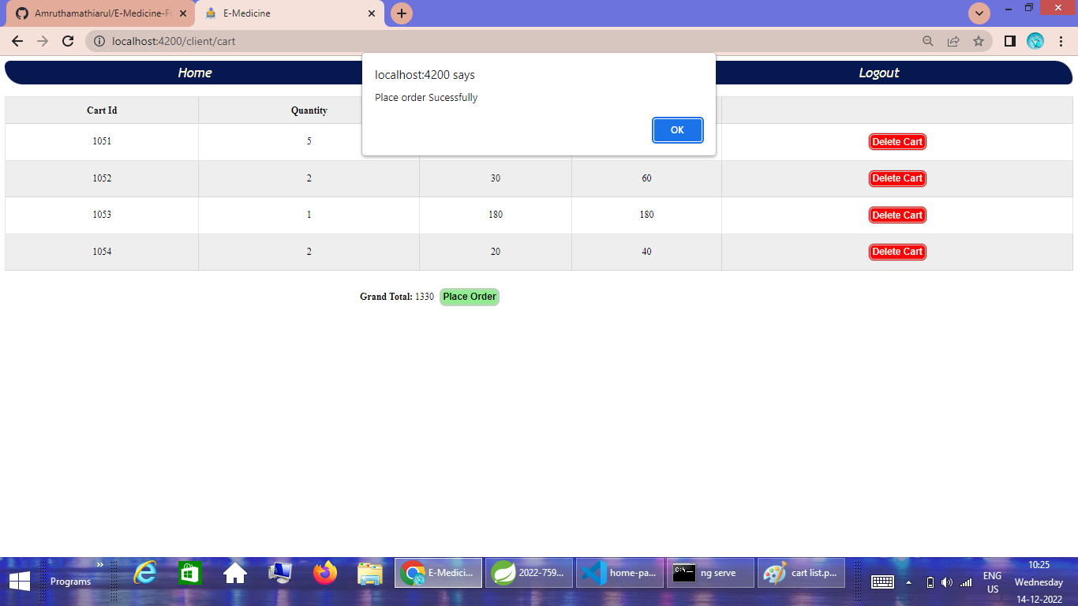

Slide 37
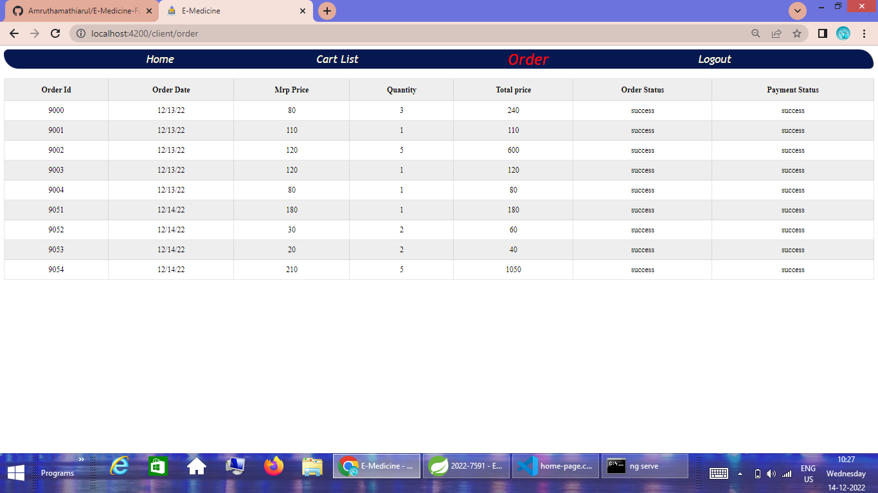

Slide 38
ADVANTAGES
One of the most important advantages of the E-Medicine application is time saving.
You do not have to go to the pharmacy and you will not be faced with waiting in line at the pharmacy.
It is very easy to order prescription drugs through E-Medicine.
Especially for people who live far away from a pharmacy, the elderly and disabled people this system is both a very easy and a very fast method of obtaining medicine.
All you have to do is to place an order by entering the prescription through the mobile application or website.
Buying drugs on the internet also saves money, studies show that buying drugs online can save a third of money in total.

Slide 39
CONCLUSION
The implementation of E- Medicine based on purchase of medicine will decrease the prescription and alterations and thus provide safety and improve the quality of service provided to the customer or patient. Therefore, we can conclude that online platform will be used for ordering of prescription based medications for customers.
By weighing the life-threatening risks of self-medication and dosing errors against the benefits of e-medicine, we propose – as a matter of public interest – that on-call pharmacists be made available to ensure validity of prescriptions as well as counsel e-medicine customers during drug purchase.

Slide 40
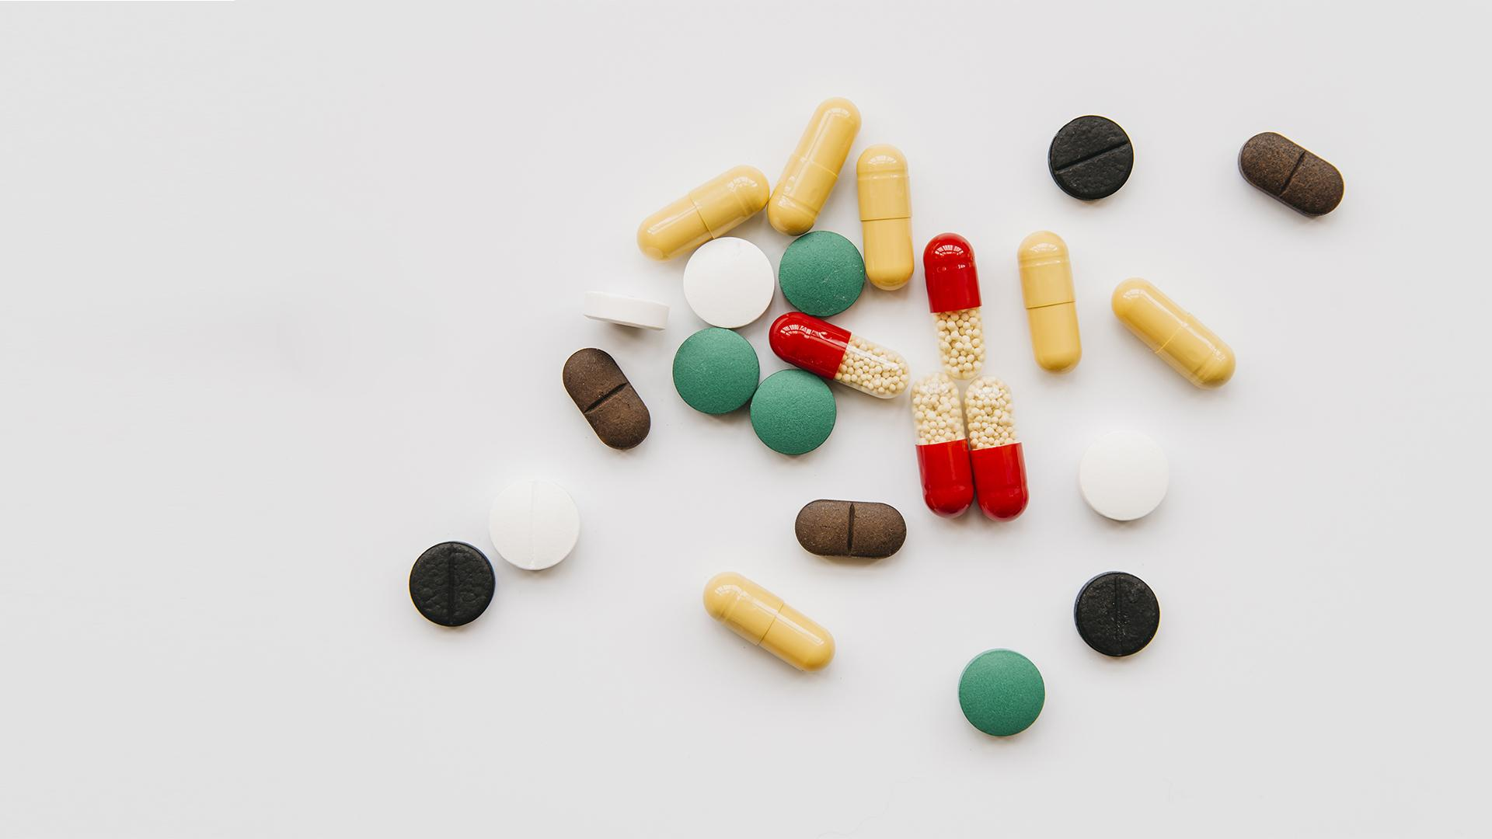
THANK YOU

